Slide 1
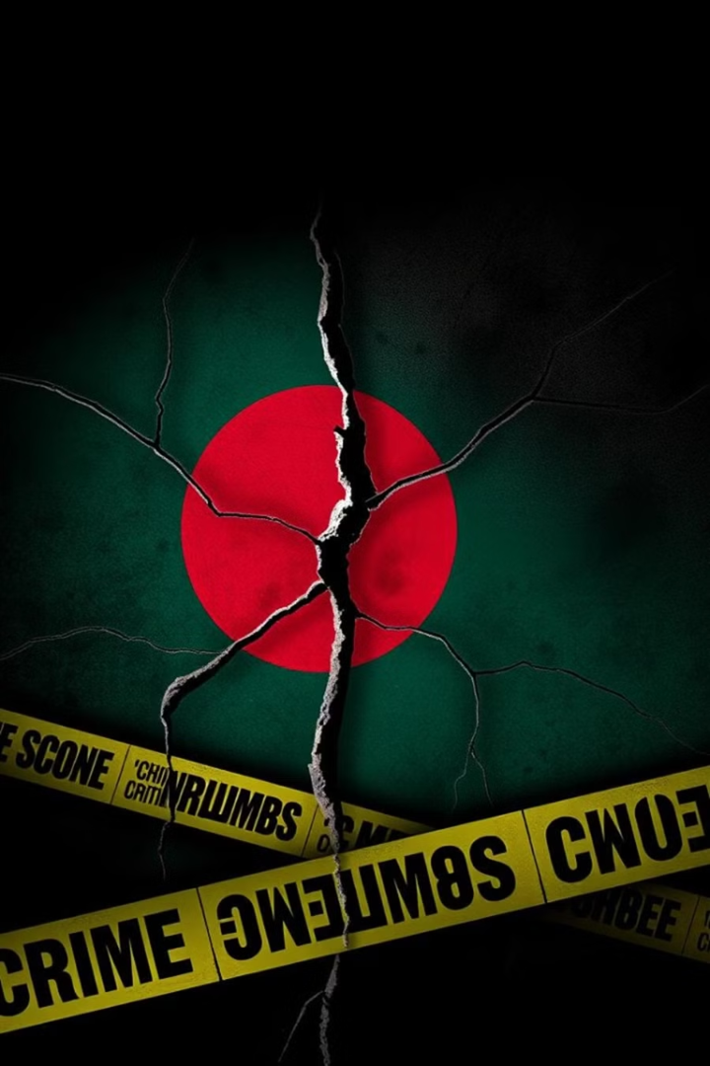
The Rising Crime Rate in Bangladesh
1)Emon Sen Dibos ID: 23201256
4) Aishee Biswas ID: 24101297
2) Tasnim Tabassum Meem ID: 23301480
5)Fairuz Hossain Madiha ID:24104189
3)Amena Akhter Akhi ID: 24101358
6)Afsara Zahir Muskaan ID:24101571

Slide 2
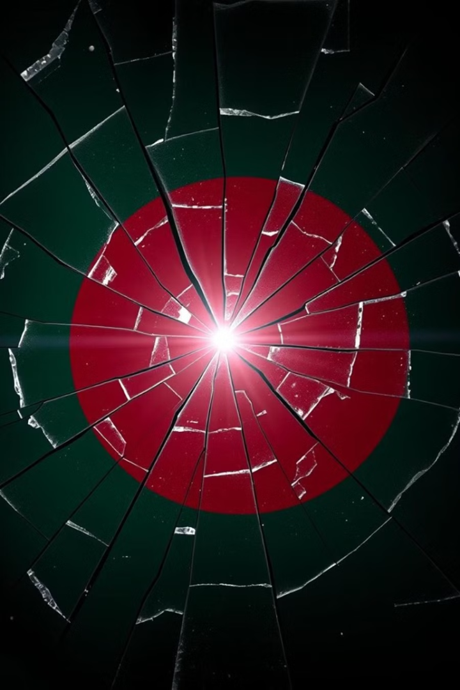
The Rising Crime Wave in Bangladesh: Stories of Pain and Injustice
Jamal (Narayanganj, February 17, 2023)
- Small business owner threatened by extortionists demanding ৳50,000 per month.
- Murdered for resisting criminal gangs.
Source: tbsnews.net
Mitu (Dhaka, June 4, 2023)
- A university student, victim of a tragic crime.
- Represents the rising violence against students and women in urban areas.
Source: berkleycenter.georgetown.edu

Slide 3
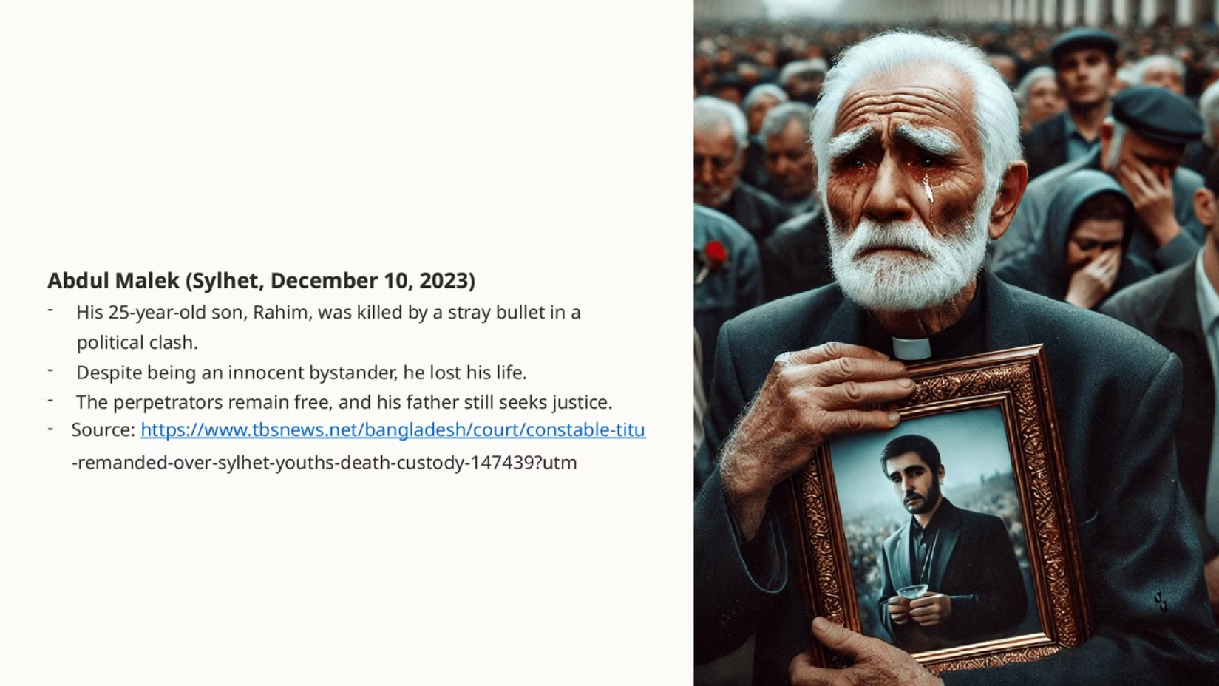

Slide 4
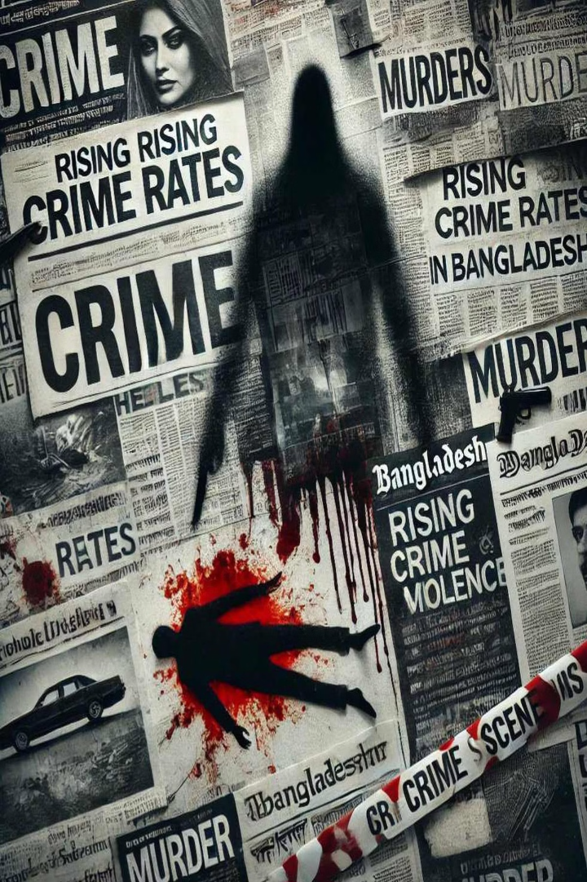
A grim reality -- Crime and justice in Bangladesh: Insights from experts.
• Political Violence: ASK reports 120+ deaths, 7000+ injured in political clashes
Justice Concerns:
Violence Against Women:
UN Human Rights Office raises alarm on lack of accountability.
Mahila Parishad records thousands of rape & assault cases (2023). UN states 80% of women face harassment in public spaces…
Ranking on criminal activities:
Global Crime Index (2021) ranks Bangladesh 41/193.

Slide 5

Recent crime rate increase
1
Murder Rate Increase (2025 vs. 2020):
The number of murders has risen by approximately 1.08 times in 2025 compared to 2020.
2
Increase in Sexual Violence (Past 9 Years):
Sexual violence has increased by 1.3% over the past 9 years.

Slide 6
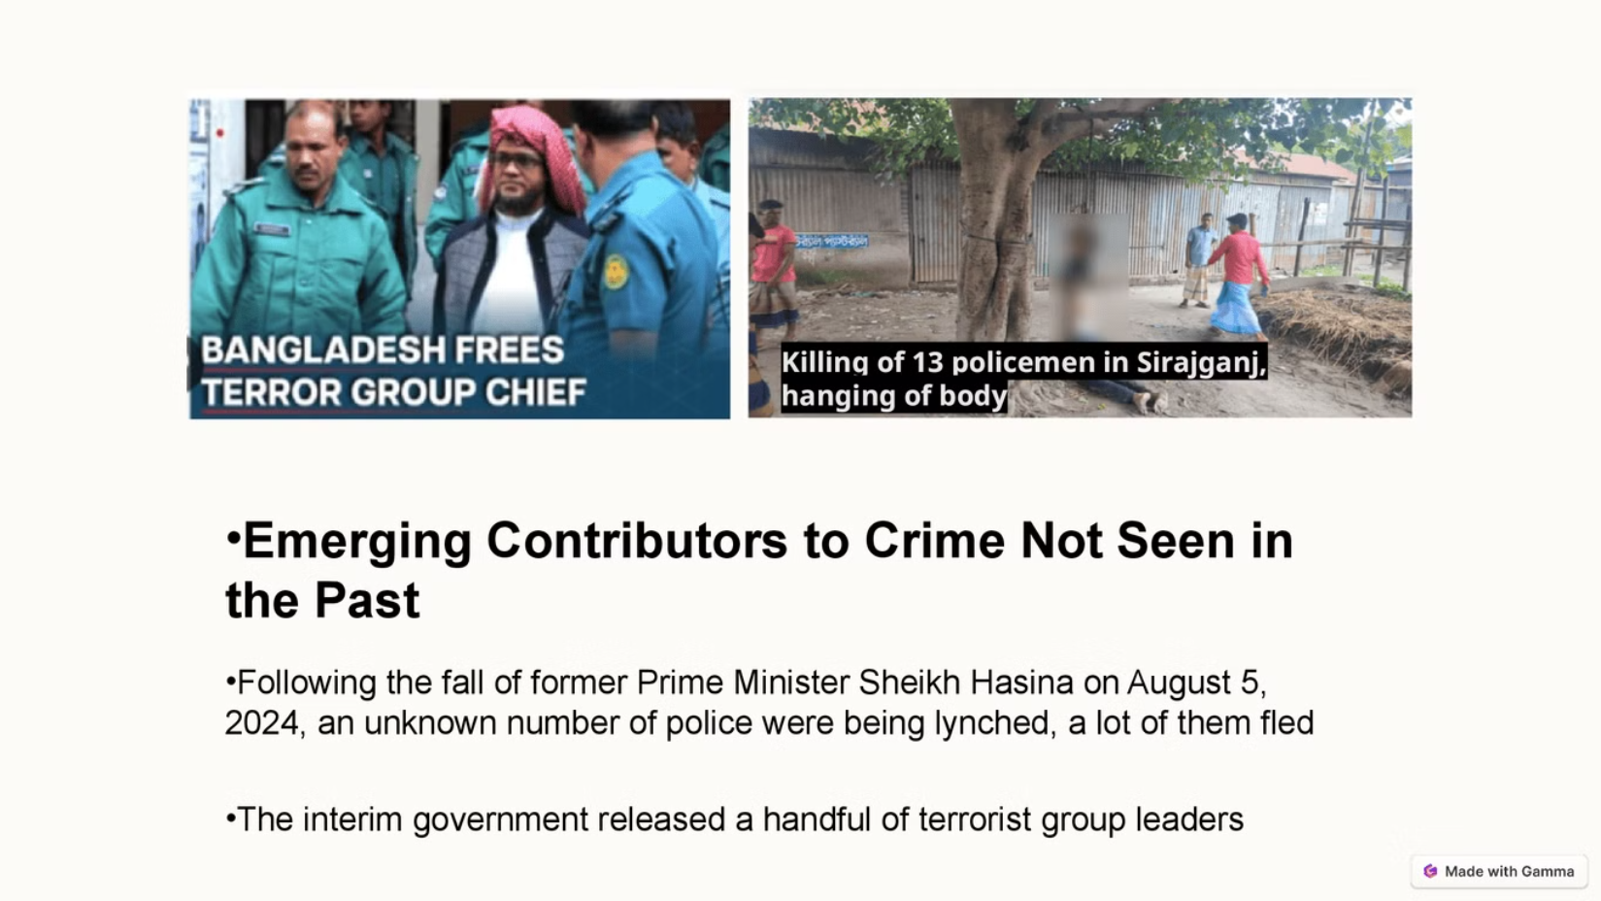


Slide 7
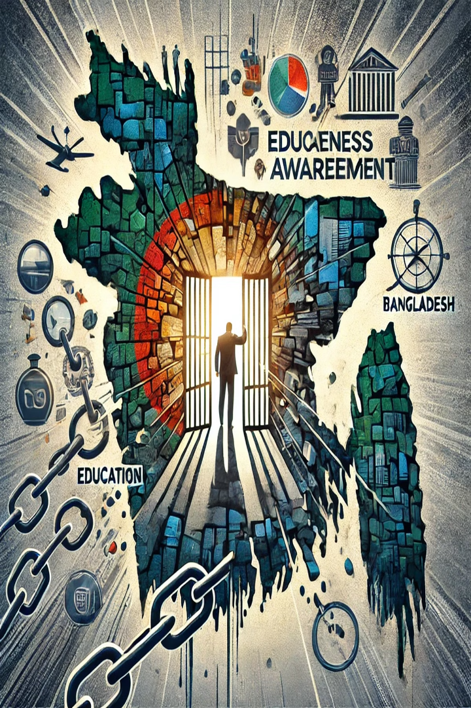
Beyond Policing: Tackling the Real Causes of Crime
Unemployment:
Limited opportunities push young people toward crime.
Corruption:
Public trust in law enforcement is low
Urbanization:
Migration to cities leads to overcrowded slums.
Political Influence:
Criminals protected by powerful figures

Slide 8
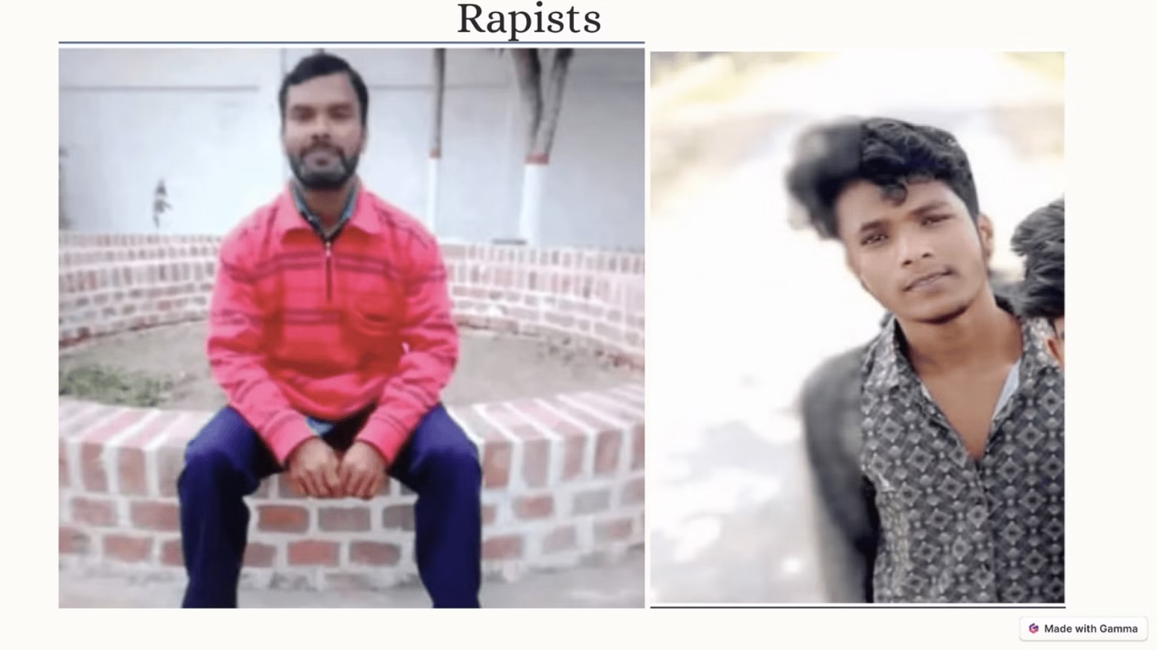

Slide 9
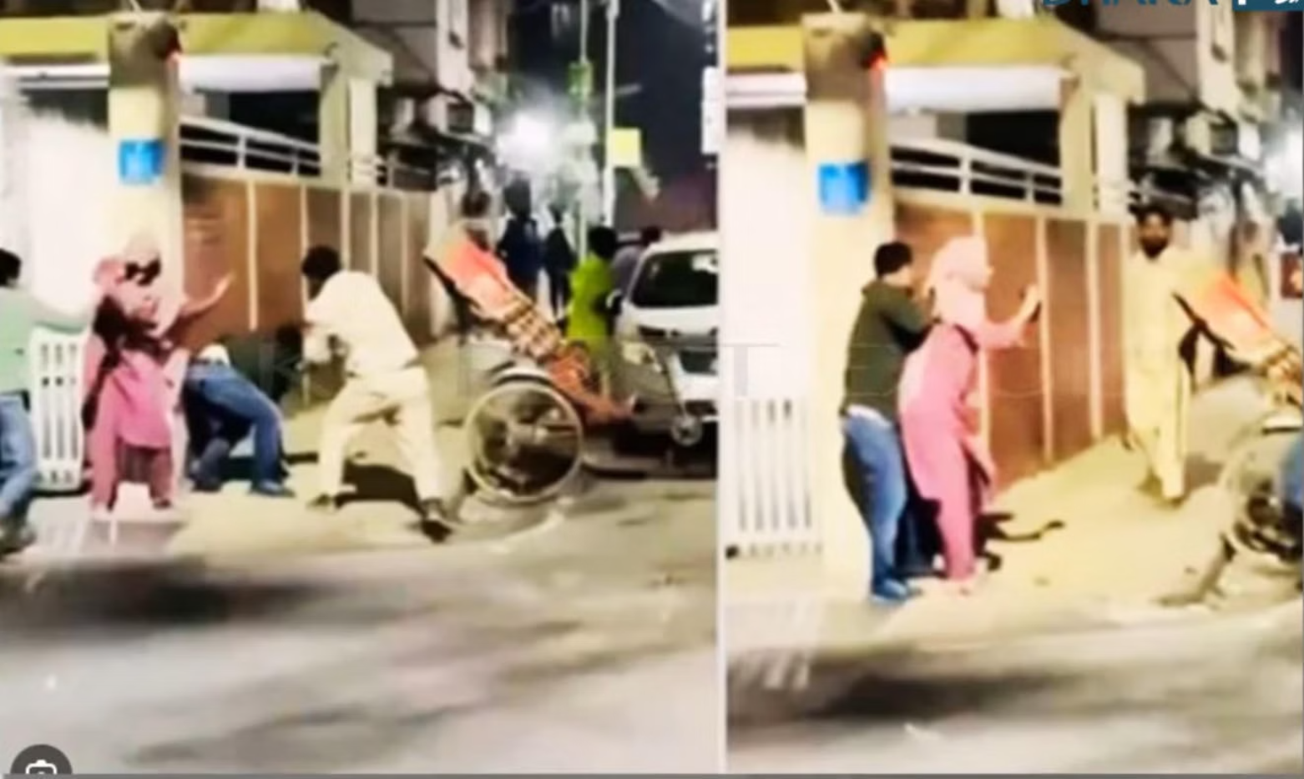

Slide 10



